Slide 1
EXPORT AWARENESS SEMINARS PRESENTATION
OVERVIEW OF EXPORT READINESS

Slide 2
export readiness assessment
Does your company has a product or Service which is available in the domestic Market? YES / NO
Production Capacity – Does your Company have sufficient production capacity to serve domestic and Export Markets? YES / NO
Finance – Does your Company have financial resources to support marketing of your products in the International market? (Which market have you Identified and which marketing tools are you going to use to market your products in that market?)
Finance – Does your Company have access to bridging finance? (Which Institutions offer bridging finance?)
Resources – Staff, Time, Storage facilities and additional Shift requirements. ( Do you have enough staff and storage facilities?)
Does your Company understand Export Process, methods of payments and Export Documentation ? (Have you attended GEPP training ?)

Slide 3
export readiness assessment
Product Modifications – Can your company be able to modify their products or services according to clients and Country requirements?
Product Standards – Is your product or service meet International standards? E.g ISO, SABS etc.
What is Certificate of Origin? (Which Institutions are mandated to issue certificate of Origin?
Marketing Plan – Does your company have marketing plan developed for exports markets? (Do you know how to develop a export marketing Strategy?)
Competition – Do you know who are your competitors, their pricing and distribution channels in the market you identified? (What are the systems which you will use to identify your competitors?)
Is your Company willing to participate in the International Trade Shows? (Do you know how to conduct yourself during trade shows?)
Does your product require export permit / Licence? (Yes / No)

Slide 4
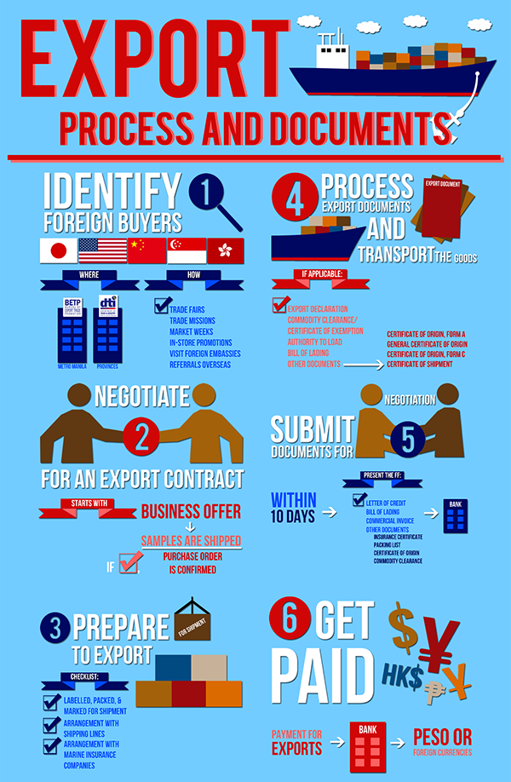
Export help desk services
Export Advice and Information
Market Access Information
Export Process and Export Documentation Information
Trade lead bulletin
Business Confirmations
How to register as an Exporter
Linking Importers with South African Buyers
Information on dti Incentives
Country Profiles
Access to all dti online Subscriptions e.g Eezy Dex, Kompass etc.
Calendar of Events (Pavillions, Missions, Seminars etc)
Trade Statistics
Export Publications
DTI Divisions Brochures

Slide 5
INTEGRATED NATIONAL EXPORT STRATEGY
EXPORT DEVELOPMENT & SUPPORT SERVICES

Slide 6
Export development & support services
EXPORT DEVELOPMENT & SUPPORT SERVICES
Trade Opportunity
Match Making
(TOC)
Export Advice & Information
(Export Help Desk)
Advice on Incentives & Financial Support
Global Exporter Passport Programmes
(GEPP)
National Exporters Database Project
Export Council Support / Industry Associations
Integrated Services

Slide 7
Export help desk services
Export Advice and Information
Market Access Information
Export Process and Export Documentation Information
Trade lead bulletin
Business Confirmations
How to register as an Exporter
Linking Importers with South African Buyers
Information on dti Incentives
Country Profiles
Access to all dti online Subscriptions e.g Eezy Dex, Kompass etc.
Calendar of Events (Pavillions, Missions, Seminars etc)
Trade Statistics
Export Publications
DTI Divisions Brochures

